Slide 1

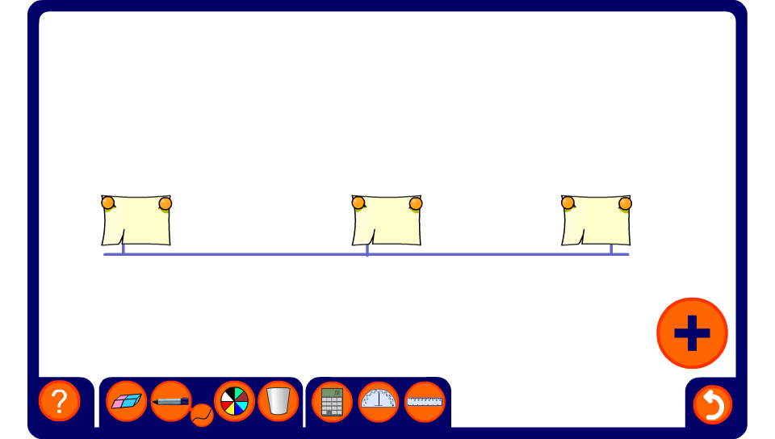


Mid-points
Notes:
Start by revealing all three fractions and ask pupils to explain (using equivalent fractions or otherwise) how we can tell that the fraction in the centre is exactly half-way between the other two.
Reset the activity, reveal two of the fractions on the line and challenge pupils to find the hidden fraction.

